Slide 1
Modern Research Methods: Introduction
13 January 2020
Molly Lewis

Slide 2
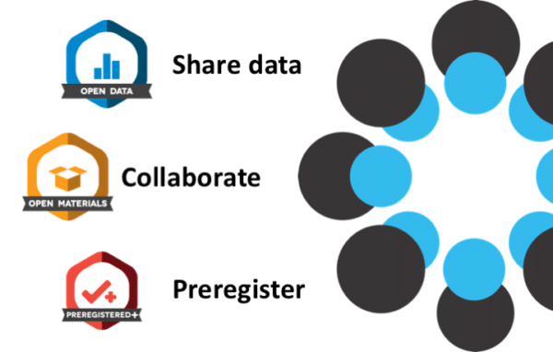
Dr. Molly Lewis
Psychologist interested in understanding how languages are learned and change over time
PhD from Stanford University in Developmental Psychology
In my own research, use combination of classical experimental methods and large scale data
Care a lot about open science and tools for open science
Notes:
About me

Slide 3
TA: Jaeah Kim
4th year PhD student in the Psychology department.
Did my undergrad at Carnegie Mellon University as well.
Currently interested in seeing how we can measure attentional states from eye-tracking data and studying how some attentional abilities might develop over childhood (especially between ages 3 and 5).

Slide 4
The Scientific Process
THEORY
Notes:
To get things started this morning, I want us to think about the scientific process
So you might think of the scientific process as starting with an idea
and then, a bunch of stuff happens
And we end up with a THEORY
In pairs of 2 -3, I want you to try to enumerate all the steps you can think of that make up this middle part
- Might help to think of a scientific theory you know about, maybe in the field of psychology
Take a few minutes to introduce yourselves
<- write out ideas on board ->

Slide 5
Case study of the scientific process: “Theory of mind”
Why did the guy jump into the swimming pool with all his clothes on?
Having a “theory of mind” (TOM) allows you to reason about the guy’s behavior when he jumped in the swimming pool
Maybe someone was drowning?
Maybe he saw a $20 bill at the bottom?
Maybe he was drunk and thought it would be fun?
Regardless: He had something in his head (a belief) that caused him to do what he did

Slide 6
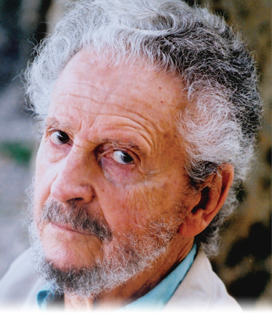
The origins of “theory of mind”
In assuming that other individuals want, think, believe, and the like, one infers states that are not directly observable and one uses these states… to predict the behavior of others as well as one’s own. These inferences, which amount to a theory of mind, are, to our knowledge, universal in human adults. Although it is reasonable to assume that their occurrence depends on some form of experience, that form is not immediately apparent. Evidently it is not that of an explicit pedagogy. Inferences about another individual are not taught, as are reading or arithmetic; their acquisition is more reminiscent of walking or speech.
Premack & Woodruff (1978): “Does the chimpanzee have a “theory of mind”?
Notes:
Indeed the only direct impact of pedagogy on these inferences would appear to be suppresive, for it is only the specially trained adult who can give an account of human behavior that does not impute states of mind.

Slide 7
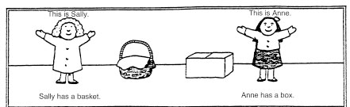
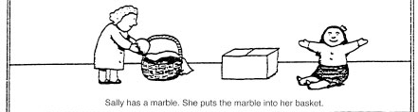
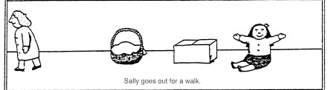
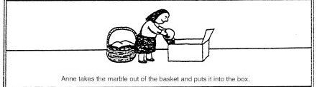
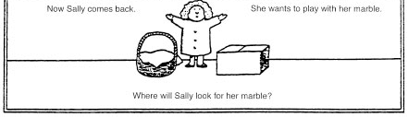
False belief: a key test
Child knowledge consistent
False belief consistent

Slide 8
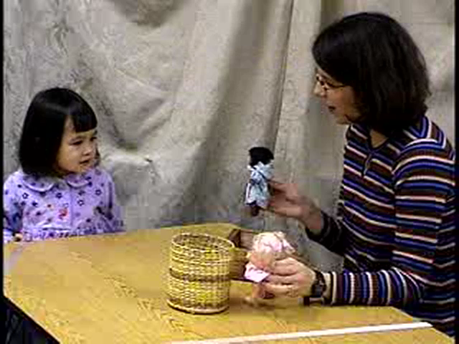

Slide 9
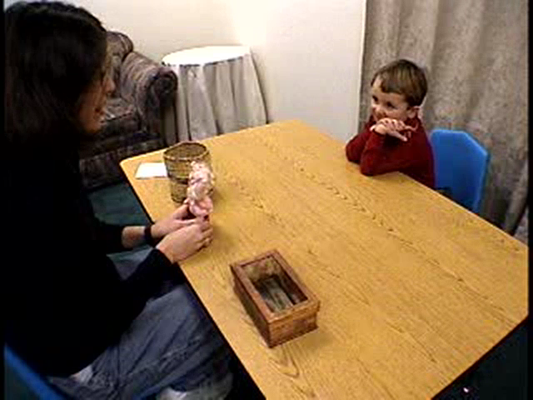

Slide 10
The Sally-Anne Task
Failure at 3 years, success at 4
Developmental pattern is very robust
Why do children fail?
Demands of the task:
Represent the true state of the world
Represent false belief
Attribute false belief to another person
Select between them on the basis of a linguistic prompt
Wimmer & Perner (1983)

Slide 11
Meta-analysis of ToM tasks
…
Things that mattered:
“Anne” having a motive
Child’s participation
Physical presence of object
Salience of mental state
Wellman (2001)

Slide 12
Related achievements
Ability to imagine alternate realities (pretending)
Ability to make people believe things that are false (lying)
Ability to take different perspectives on the same scene (representation change)
Understanding appearances can be deceiving (appearance-reality distinction

Slide 13
Representation change
Wimmer & Perner (1987)

Slide 14
Appearance – reality distinctions
Showed children a fake rock, then allowed them to see it was a sponge
Asked:
“What does this look like?” (appearance-reality)
“What did you think it was before?” (representational change)
“What would Pat think it was?” (false belief)
Gopnik & Astington (1986)

Slide 15
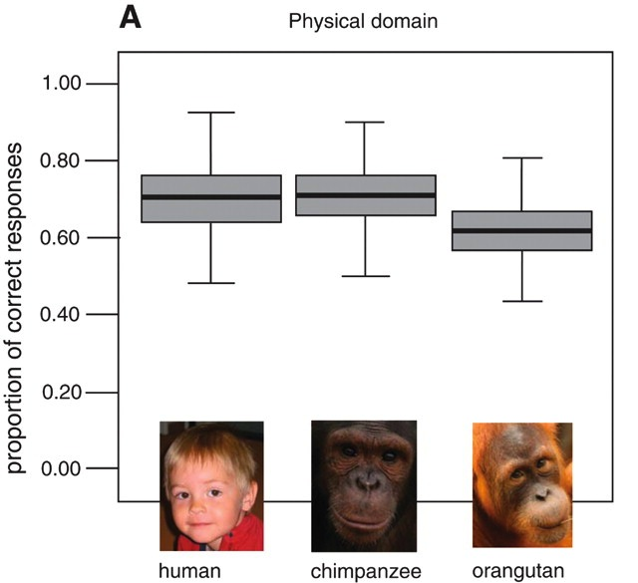
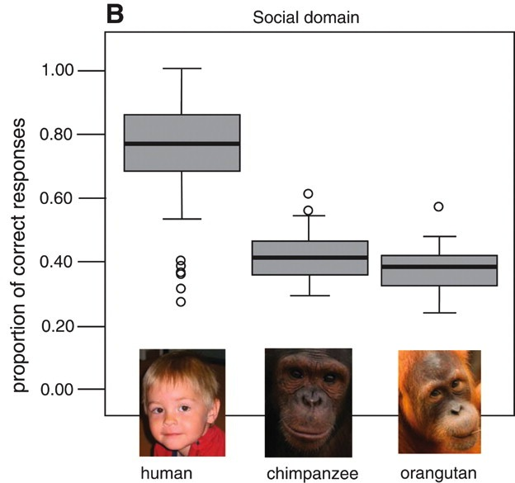
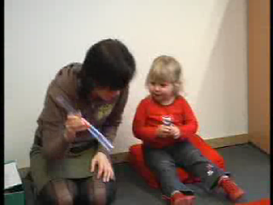
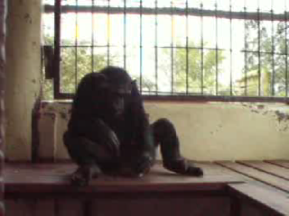
Social cognition in other primates
Hermann et al. (2007)

Slide 16
A beautiful story
Children begin reasoning about agents’ desires, goals, and actions
They then gradually develop a representational theory of mind around 3 years of age
Theory of mind is only seen in humans
…
But what if infants could also represent others’ beliefs?

Slide 17
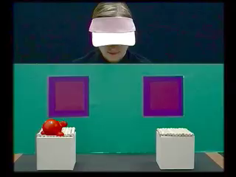
Early theory of mind
17/20 24-month-olds looked at the right window.
Southgate et al., 2007

Slide 18
Revising the theory
Complete continuity
Preschool results are artifacts
Standard tasks too difficult
TOM₁ and TOM₂
Implicit system and explicit system
One early/innate, a second one learned slowly
Other possibilities?

Slide 19
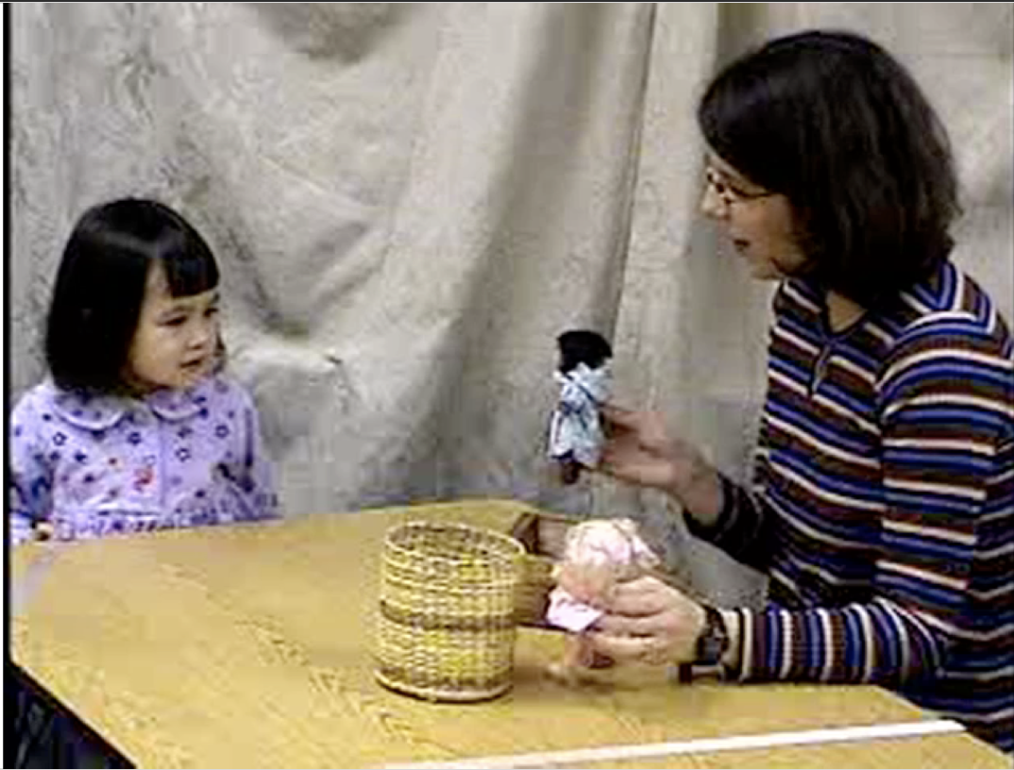
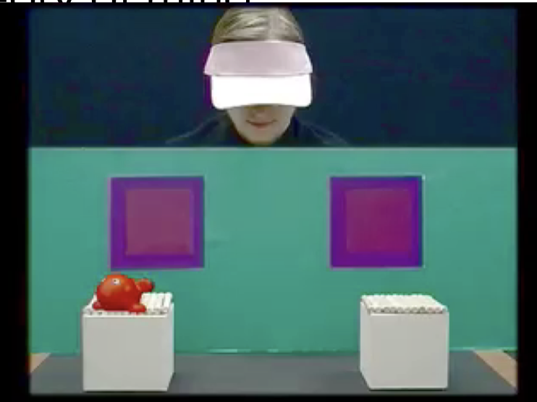
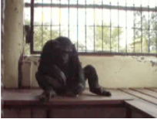
The Scientific Process
THEORY 1
THEORY 2
Notes:
To get things started this morning, I want us to think about the scientific process
So you might think of the scientific process as starting with an idea
and then, a bunch of stuff happens
And we end up with a THEORY
In pairs of 2 -3, I want you to try to enumerate all the steps you can think of that make up this middle part
- Might help to think of a scientific theory you know about, maybe in the field of psychology
Take a few minutes to introduce yourselves
<- write out ideas on board ->

Slide 20
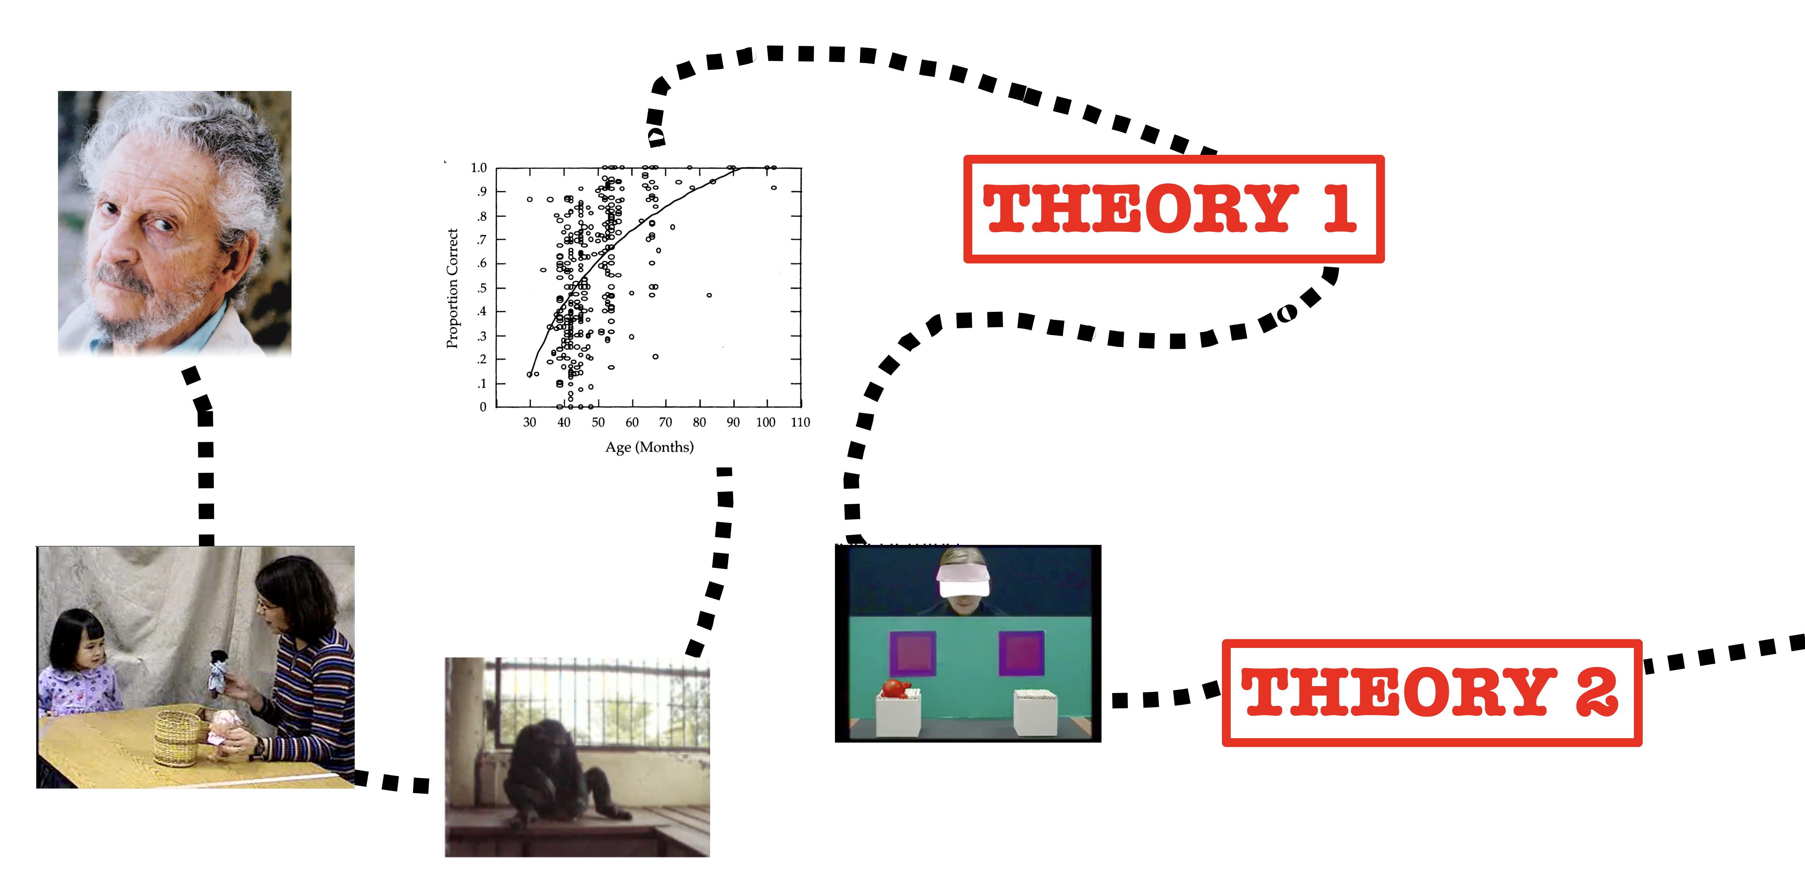
The Scientific Process is cumulative

Slide 21
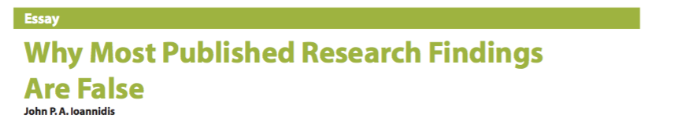

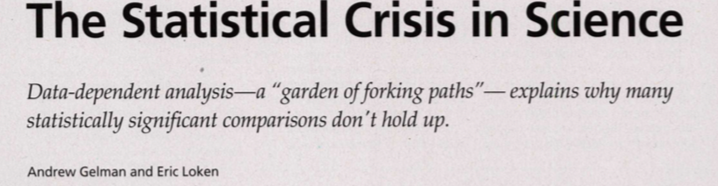
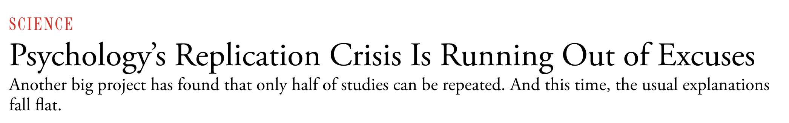
Cumulative science is hard
Sometimes doesn’t always work the way it should….
This class is about learning how to think of psychology as a cumulative science, and learning practical methods for doing so.

Slide 22
Overview of course
Philosophy of Cumulative Science
The Single Experiment – Experimental design, tools in R for working with data and plotting data, reproducibility
Repeating an Experiment – Intro to statistical concepts, replication of experiments
Aggregating Many Experiments – Meta-analysis

Slide 23
Course Logistics
Website: https://cumulativescience.netlify.com/
Includes schedule and readings, contact info, grading and other policies
Please read!!

Slide 24
Course Components
Lecture MW; Lab F (Porter 332P)
Some lecturing, some interactive
Encouraged to bring your laptop to lab
8 assignments
Typically due Thursday at noon
Must be completed individually, but can work with others
Focus on R using Rstudio.cloud (more in lab on Friday)
Take home midterm (completed individually)
Final project: Meta-analysis (completed in teams)
Participation

Slide 25
Class expectations
Do the readings – some of them will be hard
Say things! Answer my questions and respond to others’ questions/comments in class
Come to office hours when you’re having trouble with something related to the course or just want to chat about something you find interesting related to the course
Willingness to learn to program in R (no experience expected!)
Please refrain from texting or using your computer for anything other than coursework during class.

Slide 26
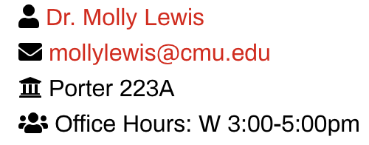

How to contact us
Email is best

Slide 27
Qs about logisitics

Slide 28
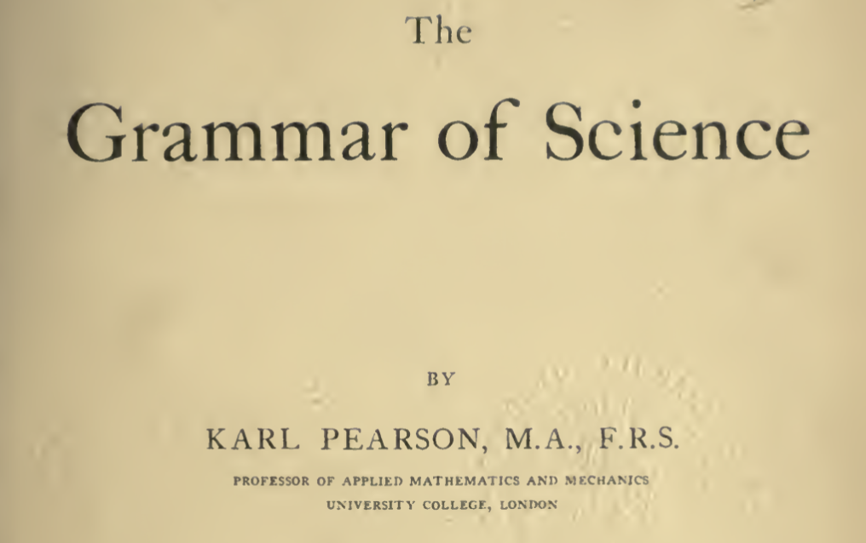
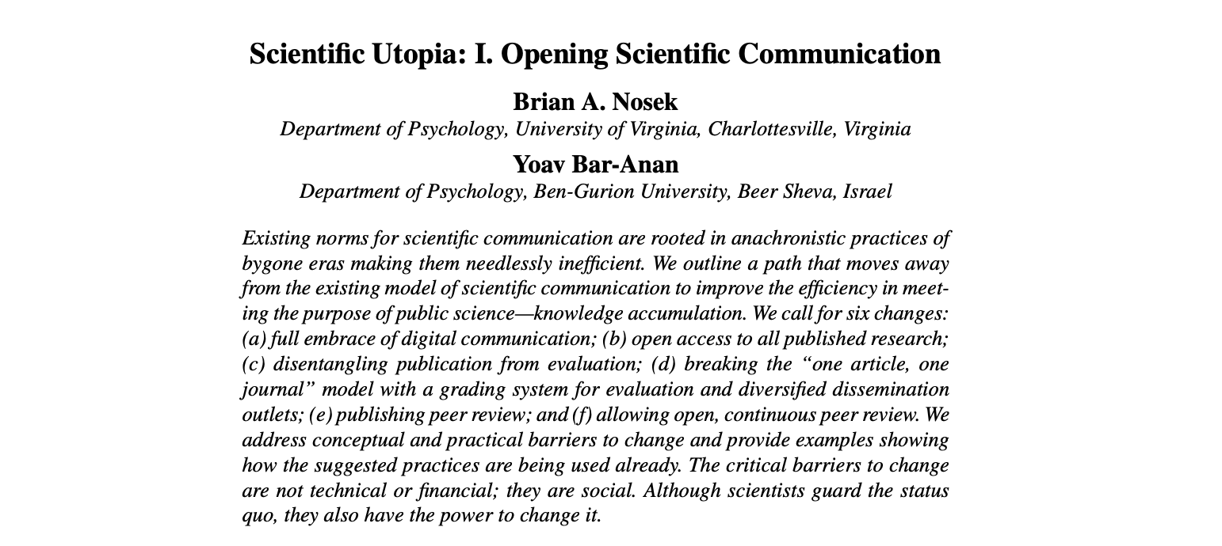
Next Time: What does the process of cumulative science actually look like?
Reading #1: Philosophy of cumulative science (Pearson)
Reading # 2 Nuts and bolts of science (Nosek et al)
Complete short survey: https://tinyurl.com/MRM-survey

Slide 29
Introduction survey:
https://tinyurl.com/MRM-survey
Course website:
https://cumulativescience.netlify.com/

Slide 30
Slides X – X in this lecture adapted from

